Slide 1
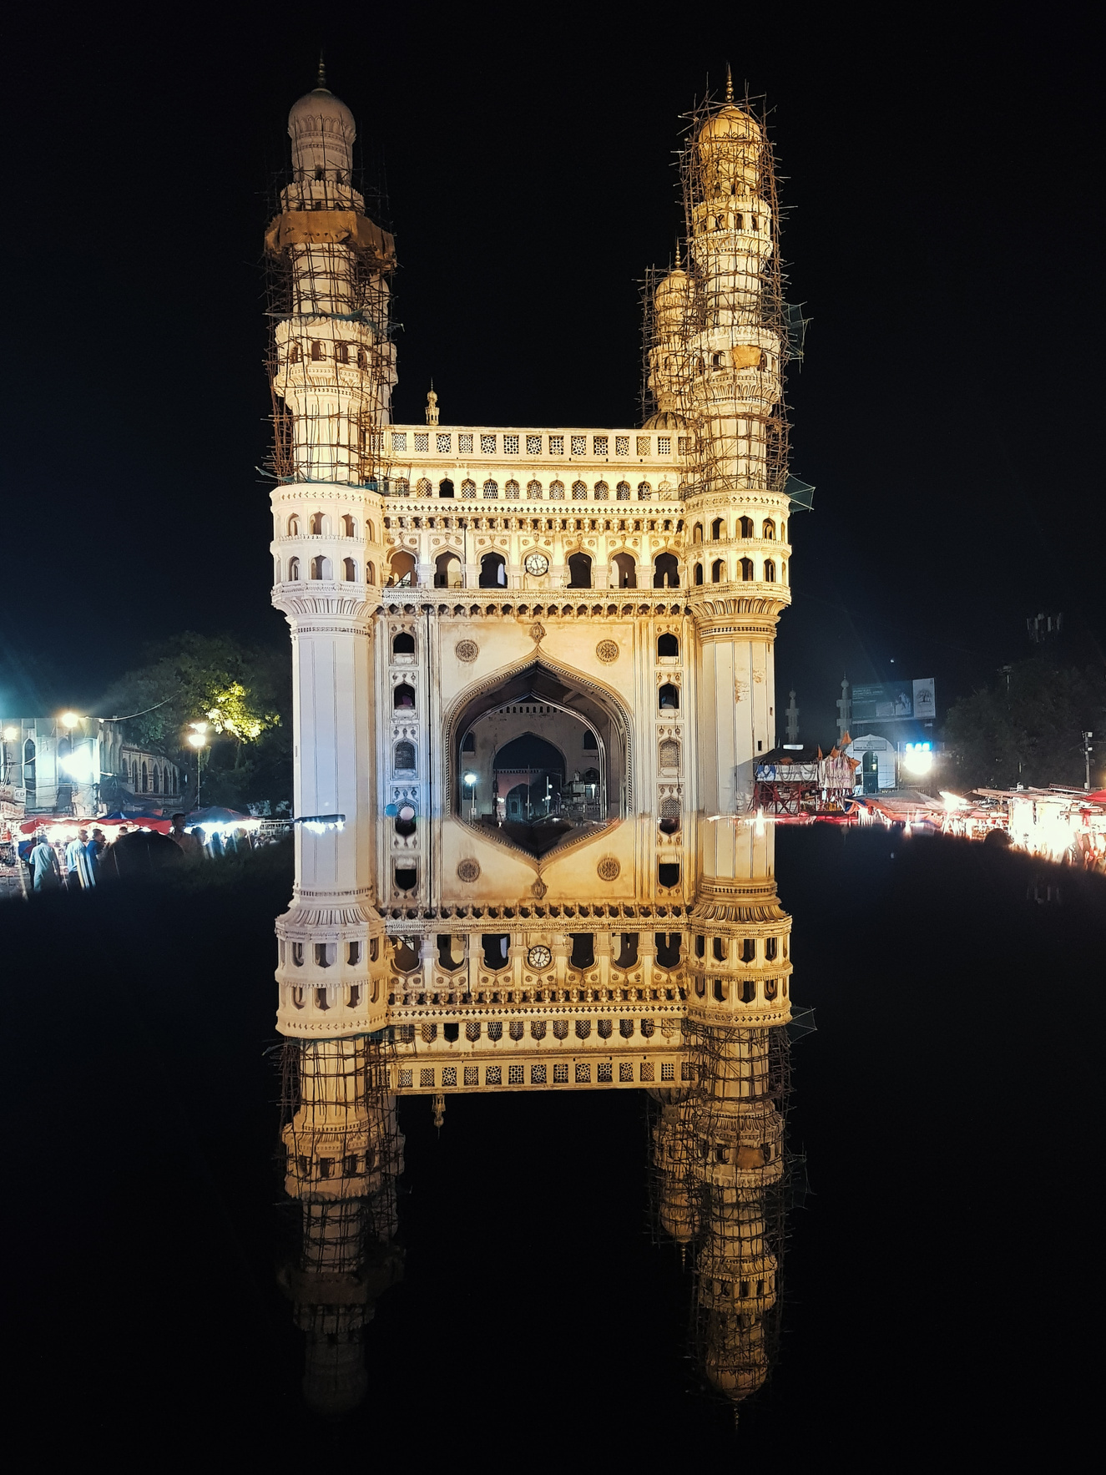


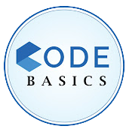
Resume Challenge#7
TELANGANA
GROWTH ANALYSIS
Presented by:
May Thu Han

Slide 2
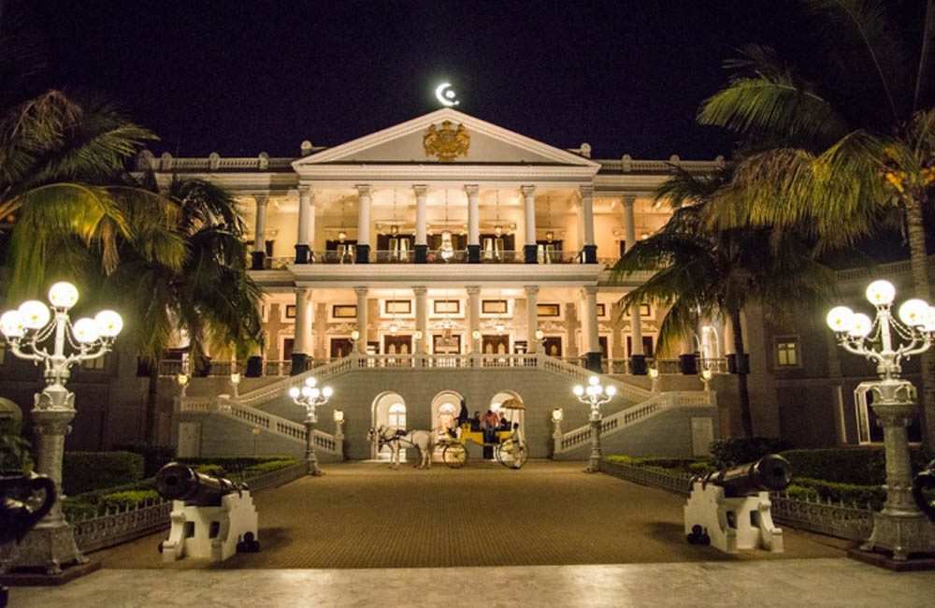
CONTENT
01
02
03
About Telangana
Objective
Questions & Findings
04
05
06
Demonstration
Insights
Recommendations

Slide 3
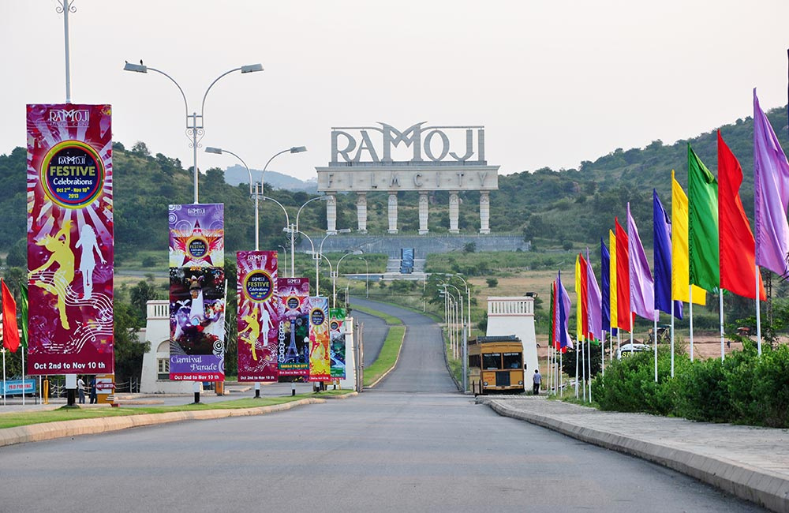
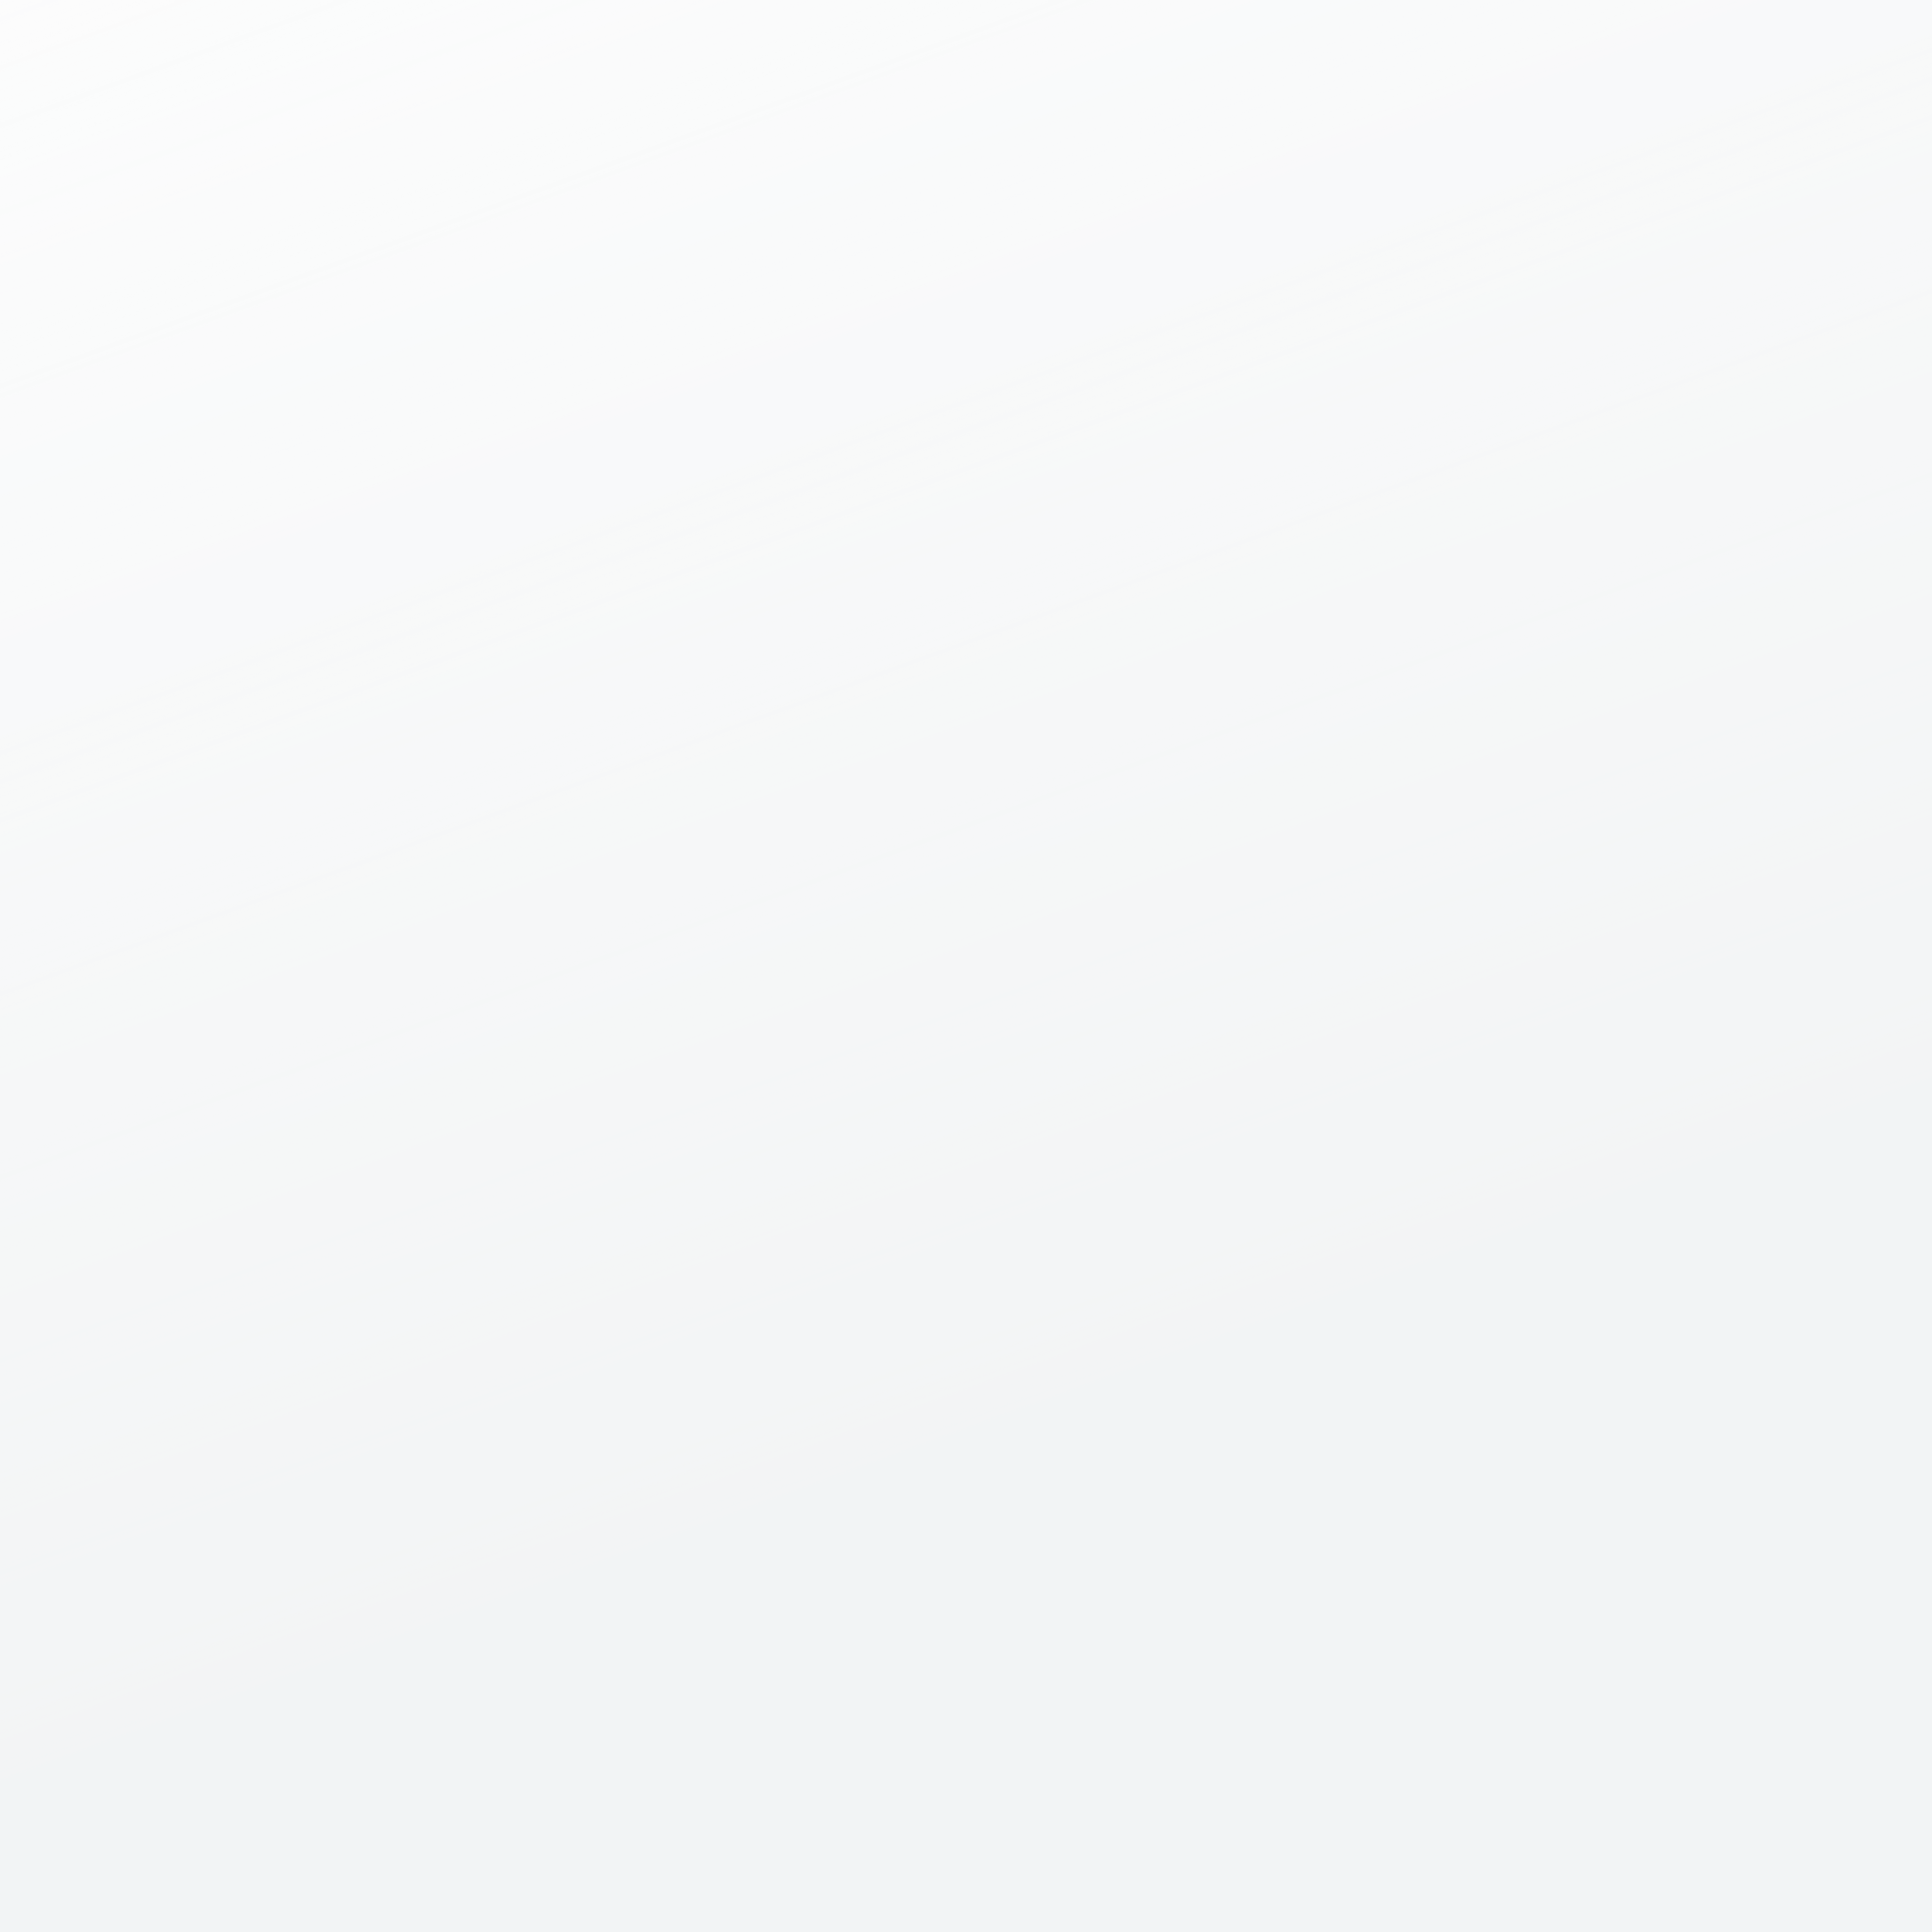

ABOUT TELANGANA
Telangana is a state in southern India known for its fast growth. It's a mix of old and new, with a rich culture and a strong economy.
The economy in Telangana is booming, especially in areas like tech, medicine, and factories. There are lots of jobs and exciting things to see, like festivals and historic places.
Telangana is also open with its data, which helps our project. We get real-time information, which means we can find useful facts to help the state grow even more.

Slide 4



OBJECTIVES
To conduct a comprehensive data analysis to evaluate Telangana's performance across various sectors
To provide the Telangana government with actionable and valuable insights
To empower the government with data-driven intelligence, enabling them to make strategic decisions that will propel Telangana's development.

Slide 5

Questions & Findings
Stamp Registration

Slide 6
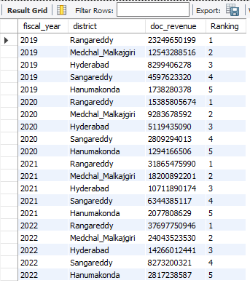
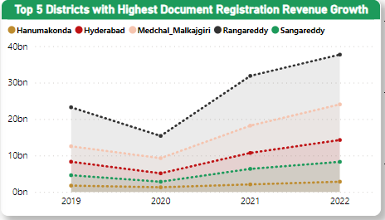
How does the revenue generated from document registration vary across districts in Telangana? List down the top 5 districts that showed the highest document registration revenue growth between FY 2019 and 2022.
Rangareddy, Medchal-Malkajgiri, Hyderabad, Sangareddy, Hanumakonda

Slide 7
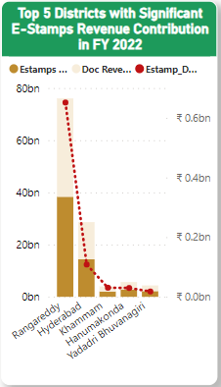
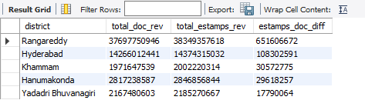
2
How does the revenue generated from document registration compare to the revenue generated from e-stamp challans across districts? List down the top 5 districts where e-stamps revenue contributes significantly more to the revenue than the documents in FY 2022?
Rangareddy, Hyderabad, Khamman, Hanumakonda, Yadadri Bhuvanagiri

Slide 8
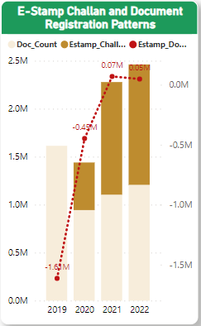
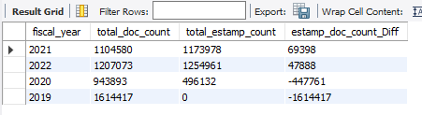
3
Is there any alteration of e-Stamp challan count and document registration count pattern since the implementation of e-Stamp challan?
Yes.
E-stamp challen registration has been going higher after 2020.

Slide 9
If so, what suggestions would you propose to the government?
Since the pandemic started making most people to get exposure to e-stamp challan registration instead of document registration, people found the use of online at ease and work done
Government should encourage more people to use e-stamp registration by pointing out that the same work could be done beneficially within less amount of time along with the easy User Interface for most people to access on their own.
Make sure the rules and laws that govern online stamping and document registration are always up-to-date with the latest technology.
Implement strong security measures to protect users' personal information online.

Slide 10
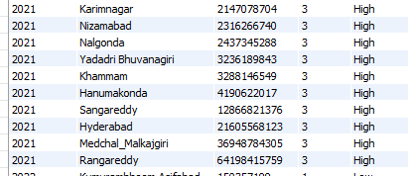
4
Categorize districts into three segments based on their stamp registration revenue generation during the fiscal year 2021 to 2022.
HIGH CATEGORY (2021)
Rangareddy, Medchal_Malkajgiri, Hyderabad,...

Slide 11
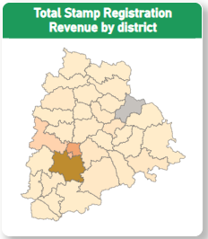
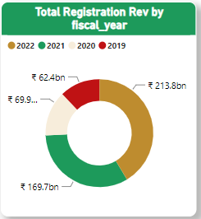
4.
Categorize districts into three segments based on their stamp registration revenue generation during the fiscal year 2021 to 2022.
2021 and 2022 have a higher contribution.

Slide 12
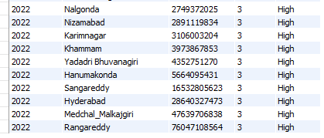
4
Categorize districts into three segments based on their stamp registration revenue generation during the fiscal year 2021 to 2022.
HIGH CATEGORY (2022)
Rangareddy, Medchal_Malkajgiri, Hyderabad,...

Slide 13
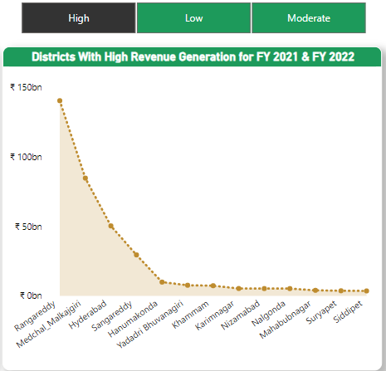
4
Categorize districts into three segments based on their stamp registration revenue generation during the fiscal year 2021 to 2022.
HIGH CATEGORY (2021 - 2022)
Rangareddy,
Medchal_Malkajgiri,
Hyderabad,...

Slide 14
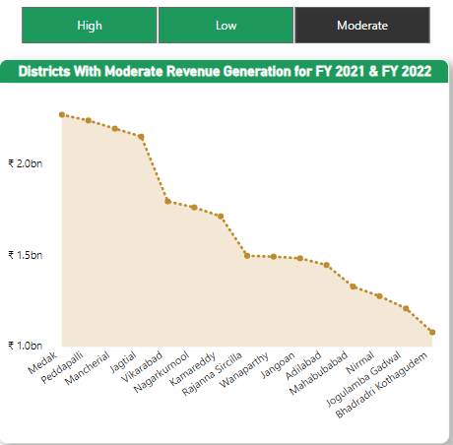
4
Categorize districts into three segments based on their stamp registration revenue generation during the fiscal year 2021 to 2022.
MODERATE CATEGORY
(2021 - 2022)
Medak,
Peddapalli,
Mancherial, ...

Slide 15
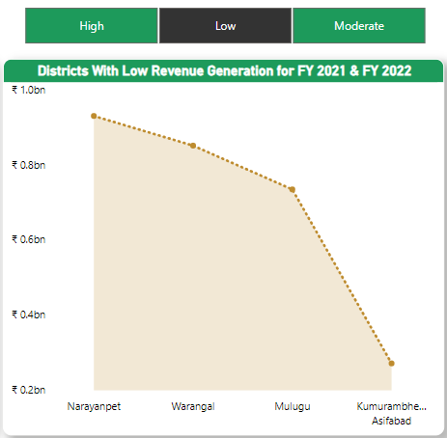
4
Categorize districts into three segments based on their stamp registration revenue generation during the fiscal year 2021 to 2022.
LOW CATEGORY
(2021 - 2022)
Narayanpet,
Warangal,
Mulugu, ...

Slide 16

Questions & Findings
TRANSPORTATION

Slide 17
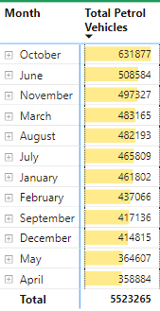
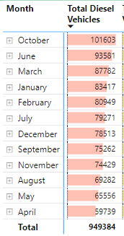
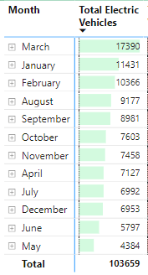
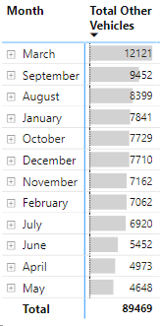
1
Are there any months or seasons that consistently show higher or lower sales rate, and if yes, what could be the driving factors?

Slide 18
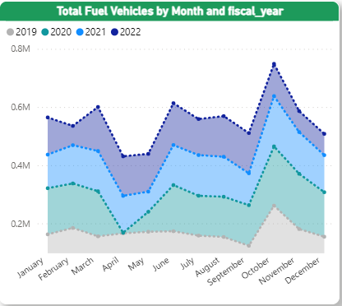
1
Are there any months or seasons that consistently show higher or lower sales rate, and if yes, what could be the driving factors?
October,
November,
December,
June,
March
January

Slide 19
1
Are there any months or seasons that consistently show higher or lower sales rate, and if yes, what could be the driving factors?
October
People buy more during festivals like Diwali.
November
The festive spirit continues, and there are year-end deals.
December
Dealerships offer deals to clear out old inventory before the year ends.

Slide 20
1
Are there any months or seasons that consistently show higher or lower sales rate, and if yes, what could be the driving factors?
June
New car models come out, and it's just before the rainy season.
March
It's the end of the financial year, so some buy for tax reasons.
January
New year, new purchases and some have extra money from December bonuses.

Slide 21
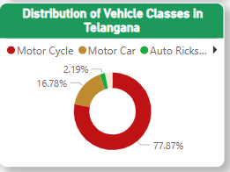
2.
How does the distribution of vehicles vary by vehicle class (MotorCycle, MotorCar, AutoRickshaw, Agriculture) across different districts?
Motor Cycle (77%)
Motor Car (16%)
Auto Rickshaw (2%)
Agriculture

Slide 22
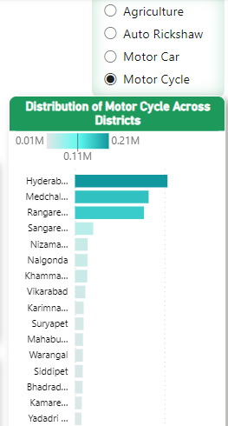

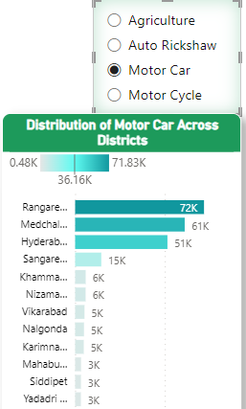

2
Are there any districts with a predominant preference for a specific vehicle class? Consider FY 2022 for analysis.
Hyderabad
Medchal_Malkajgiri,
Rangareddy
Rangareddy
Medchal_Malkajgiri,
Hyderabad

Slide 23
WHY?
These urban areas often face significant traffic congestion, making personal vehicles like motorcycles and cars more appealing for quicker and more convenient commuting.
Residents in these cities have diverse commuting needs, ranging from short daily trips to longer journeys. Having both motorcycles and cars allows them to meet these varied transportation requirements.
These cities have a wide range of income levels. Motorcycles are more affordable than cars, so they are an attractive option for a broader spectrum of residents.
Both vehicles serve last-mile connectivity to destinations beyond public transport reach.

Slide 24
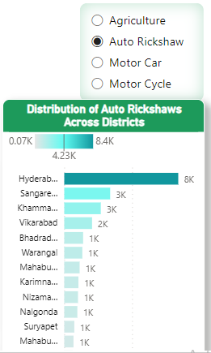

2
Are there any districts with a predominant preference for a specific vehicle class? Consider FY 2022 for analysis.
Auto-rickshaws are widely used in urban and semi-urban areas throughout Telangana
Hyderabad (8K)
Sangareddy(3K),
Khammam
They can easily move through crowded city streets, making them a convenient choice for urban travel.
They provide a cost-effective mode of transportation for short journeys

Slide 25
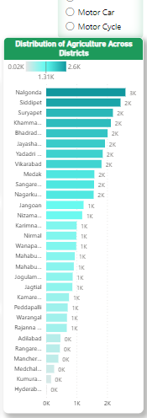

2
Are there any districts with a predominant preference for a specific vehicle class? Consider FY 2022 for analysis.
Agriculture and related activities play a crucial role in the state's economy
Nalgonda (3K),
Siddipet (2K),
Suryapet, Khammam
They have large areas of farmland and rely on machines like tractors and harvesters to make farming more efficient and productive.

Slide 26
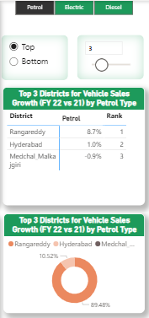

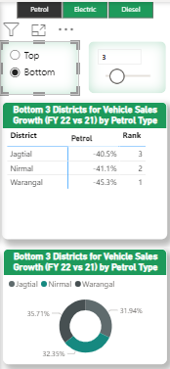

3
List down the top 3 and bottom 3 districts that have shown the highest and lowest vehicle sales growth during FY 2022 compared to FY 2021?
Rangareddy
Hyderabad
Medchal_Malkajgiri
Jagtial
Nirmal
Warangal

Slide 27
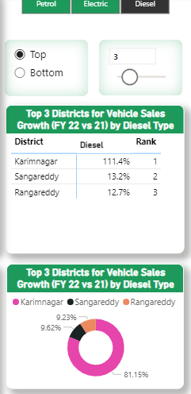

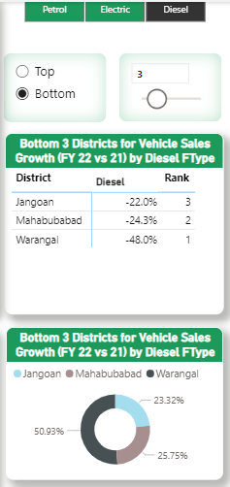
3
List down the top 3 and bottom 3 districts that have shown the highest and lowest vehicle sales growth during FY 2022 compared to FY 2021?
Karimnagar
Sangareddy
Rangareddy
Jangoan
Mahabubabad
Warangal

Slide 28
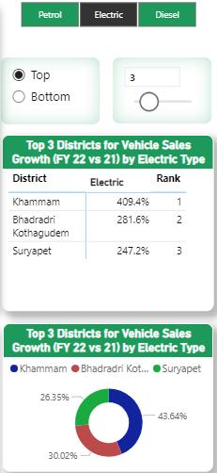

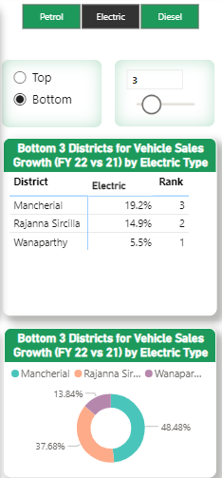
3
List down the top 3 and bottom 3 districts that have shown the highest and lowest vehicle sales growth during FY 2022 compared to FY 2021?
Khammam
Bhadradri Kothagudem
Suryapet
Mancherial
Rajanna Sircilla
Wanaparthy

Slide 29

Ts-Ipass
(Telangana State Industrial Project Approval & Self Certification System)
Questions & Findings

Slide 30
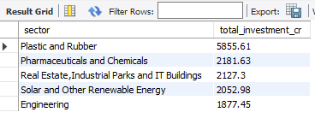
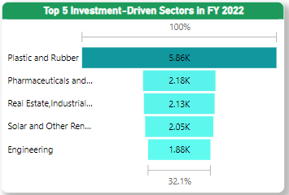
1
List down the top 5 sectors that have witnessed the most significant investments in FY 2022.
Plastics & Rubber
Pharmaceuticals & Chemicals
Real Estate, Industrial Parks & IT Buildings
Solar and other Renewable Energy
Engineeering

Slide 31
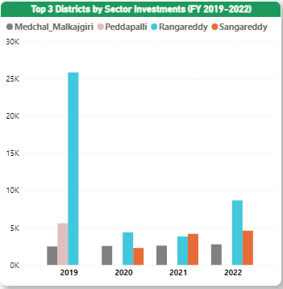
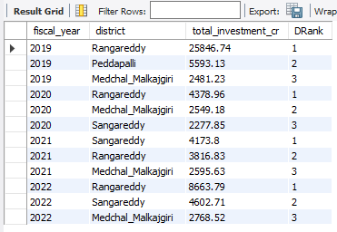
2
List down the top 3 districts that have attracted the most significant sector investments during FY 2019 to 2022?

Slide 32
2
What factors could have led to the substantial investments in these particular districts?
Growing industries and infrastructure
Presence of business hubs
Ongoing development
Abundant growth potential

Slide 33
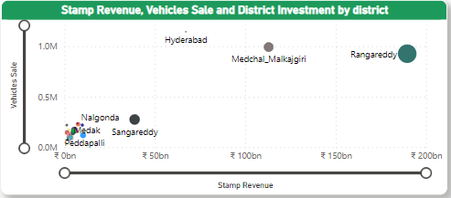
3
Is there any relationship between district investments, vehicle sales and stamps revenue within the same district between FY 2021 & 2022?
size -> Investment

Slide 34
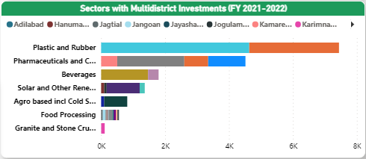
4
Are there any particular sectors that have shown substantial investment in multiple districts between FY 2021 and 2022?

Slide 35
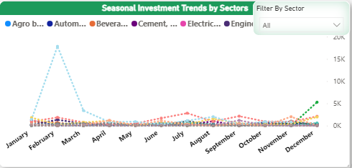
5
Can we identify any seasonal patterns or cyclicality in the investment trends for specific sectors?

Slide 36
5.
Do certain sectors experience higher investments during particular months?
Real Estate, Industrial Parks, and IT Buildings see higher investments in February due to favorable government policies, tax incentives, and project timelines converging during this time, making it an opportune period for investors.
Fertilizers, both organic and inorganic, pesticides, and insecticides sector often experience higher investments in December due to the winter cropping season and the need for agricultural inputs to prepare for the upcoming planting season in early spring.
The beverage sector in Telangana tends to have higher investments in January, February, May, November, and December because these months coincide with various festivals, holiday seasons, and increased demand for beverages. During these periods, people often celebrate and consume drinks more, leading to increased production and investment in the industry to meet the rising demand.

Slide 37

Questions & Findings
MORE RESEARCH

Slide 38
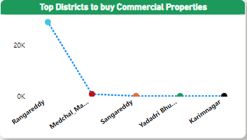
1
What are the top 5 districts to buy commercial properties in Telangana? Justify your answer

Slide 39
1
What are the top 5 districts to buy commercial properties in Telangana? Justify your answer
Close to Urban Centers - These districts are near big cities like Hyderabad, which is good for business.
Better Infrastructure - They have good roads and facilities for businesses.
Growth Opportunities - The economy is growing, which is great for companies.
Skilled Workers - There are skilled workers available for businesses.
Property Value - The properties can go up in value, making them a good investment.

Slide 40
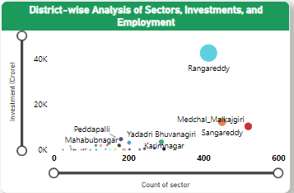
2
District-wise Analysis of Sectors, Investments, and Employment in Telangana

Slide 41
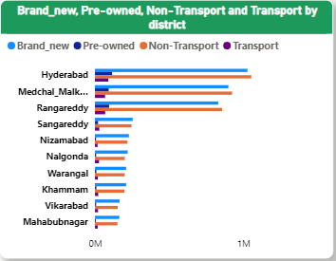
3
How does the distribution of Brand_new, Pre-owned, Non-Transport, and Transport sectors vary across different districts?

Slide 42





4
What significant policies or initiatives were put into effect to enhance economic growth, investments, and employment in Telangana by the current government?
01
02
03
Industrial Policy
TS-iPASS
Investment Subsidies
Telangana's proactive industrial policy encourages investments in various sectors, making it easier for businesses to set up and operate within the state.
It streamlines the process ofIt obtaining approvals and clearances for businesses, reducing bureaucratic hurdles.
The government offers subsidies and incentives to attract investments, including capital subsidies, power cost reimbursements, and more.
04
05
06
T-Hub
Infrastructure Development
Ease of Doing Business
T-Hub is India's largest startup incubator and innovation center, supporting entrepreneurship and fostering innovation in the state.
Telangana has invested significantly in infrastructure development, improving connectivity, and creating an enabling environment for businesses.
Telangana has invested significantly in infrastructure development, improving connectivity, and creating an enabling environment for businesses.

Slide 43

INSIGHTS
Top 5 Insights
1: Top 3 Leading Districts in Telangana
Rangareddy, Medchal_Malkajgiri, and Sangareddy thrive in investment, employment, and sectors due to their strategic location, strong infrastructure, and business-friendly government policies, making them preferred destinations for investors and industries.
2 : Top Districts Driving Transportation in Telangana
Cities like Hyderabad, Medchal_Malkajgiri, Rangareddy, Sangareddy, and Nizamabad are driving Telangana's vehicle boom due to rapid urbanization and population growth, leading to increased demand for cars and bikes.
--->

Slide 44
INSIGHTS
Top 5 Insights
3 : E-stamp Challan Growth More Since Pandemic
Document registration had been leading before pandemic in Telangana. Since 2020, there is a significant growth in E-stamp registration and it has been leading.
4 : Annual Improved Registration Revenue
Total Generated Registration Revenue from Telangana is performing better Year-Over-Year from 2019-2022.
5 : Consistent Growth in Fuel Vehicle Sales in October
Fuel vehicle sales reach to the roof in Oct and Nov for four consecutive years because of festivals, new model introductions, and clearance of outgoing model stocks with substantial discounts and benefits at car showroom.

Slide 45
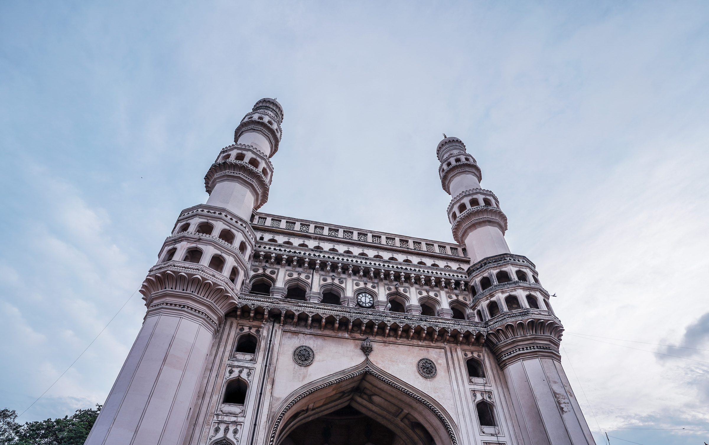
MY
RECOMMENDATIONS
Enhancing Urban Employment in Telangana
The government should focus on skill development, support for startups, and diversification of industries in cities. This approach aims to boost urban employment, stimulate economic growth, and create more job opportunities.
Achieving Balanced Economic Growth in Telangana
Telangana should work to ensure that economic growth benefits all areas and communities, not just a few. This means creating jobs, protecting the environment, and exploring new industries to make the economy stronger and fairer for everyone.

Slide 46
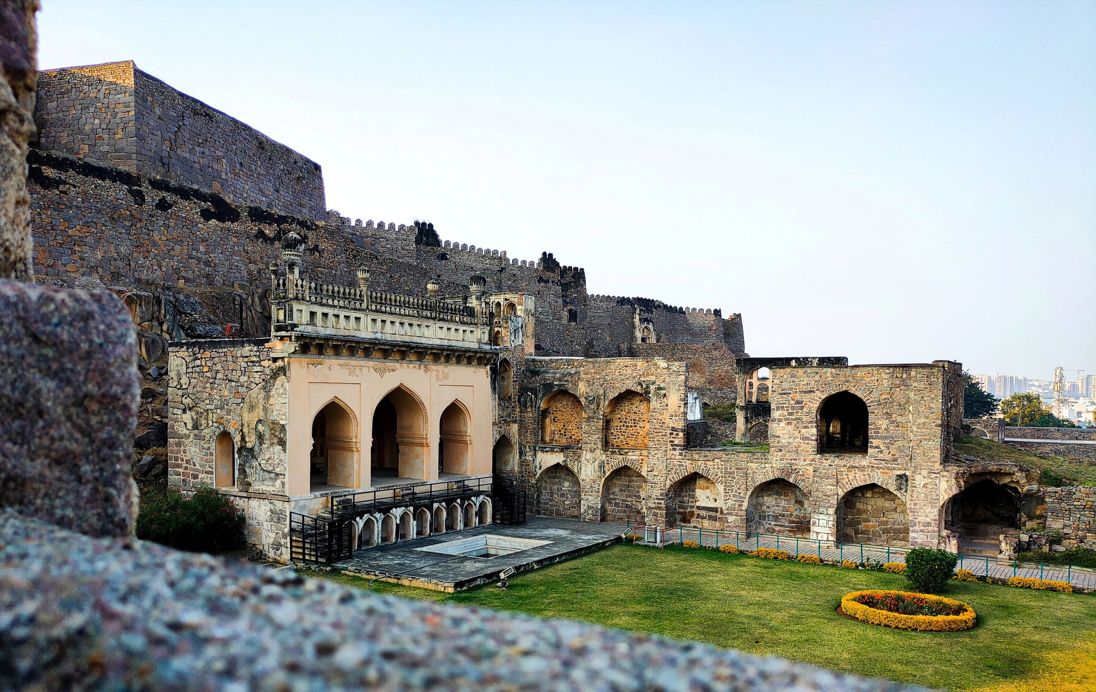
MY
RECOMMENDATIONS
Investing in Sustainable Infrastructure
Allocate resources for sustainable infrastructure development that enhances transportation, digital access, and connectivity while minimizing harm to the environment.
Advancing Agriculture through Innovation
Encourage innovation in agriculture by adopting technology and sustainable practices. Support farmers in implementing modern techniques for higher productivity and environmental conservation.
Leading the Way in Environmental Conservation
Start programs to safeguard our environment, such as planting more trees, managing water wisely, and reducing pollution. Encourage businesses and communities to be more eco-friendly by offering incentives for environmentally responsible practices.

Slide 47

THANK YOU
Telangana Government
Codebasics Team
1. Kalvakuntla Taraka Rama Rao / KTR
Minister for IT, Industries and Municipal Administration:
2. Jayesh Ranjan
Secretary, Information Technology (IT); Government of Telangana:
3. Dileep Konatham
Director at Government of Telangana
4. Venu Panjarla
Open Data Telangana
1. Dhaval Patel
Founder, Codebasics
2. Hemanand Vadivel
Co-Founder, Codebasics

